Slide 1
Smart Notification system to reduce Push Notifications for e-commerce apps
Team – GecaToons
Government College of Engineering, Aurangabad

Slide 2
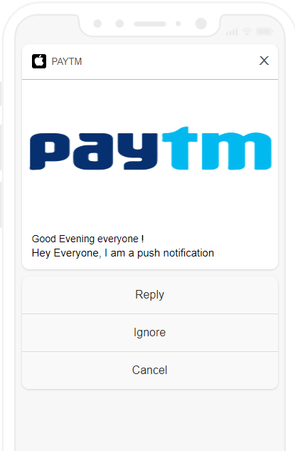
Push Notifications are one of the most important categories in general notifications. They are quite engaging and are used by developers to promote their content, keep their users engaged to the app, reduce app churn-out rates, send out vital app content, access user opinions and data, etc.

Slide 3

Offers/Promotions
Information
Cricket Scores
Coupons
Social Feed
Weather Alerts
Payment Related
WhatsApp
Messaging
Alerts

Slide 4
“I got 99 problems and irrelevant push notifications are one of them”
- Frustrated Android User
“With great push power comes great responsibility”
-Anonymous

Slide 5
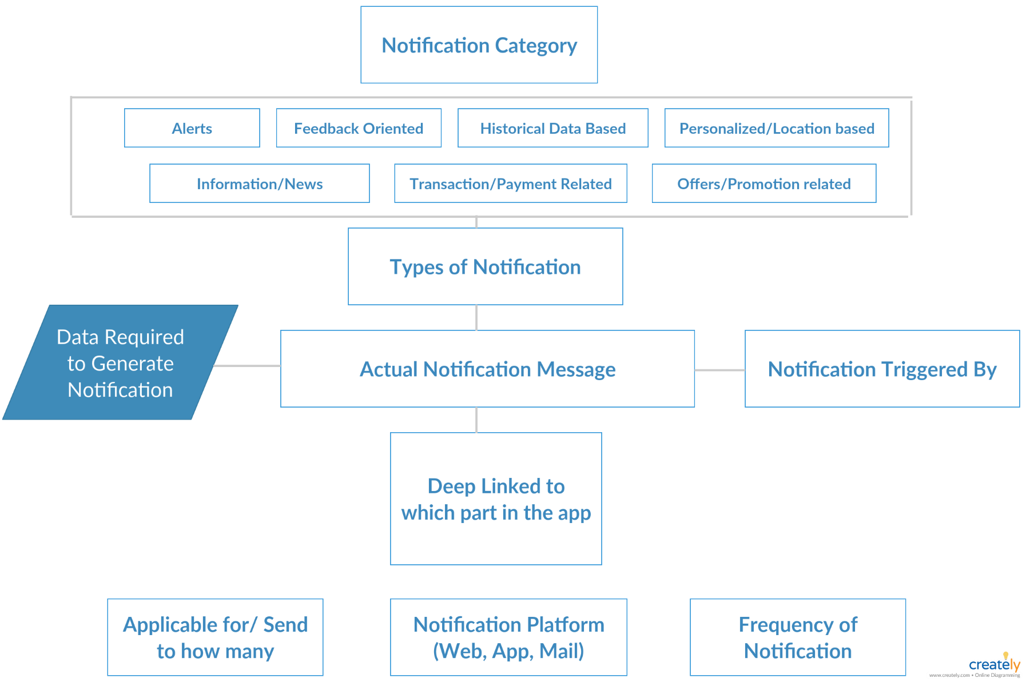
Fig 1. Simple Notification Architecture

Slide 6
Our Approach

Slide 7
Search History
Behavioural Patterns
Time spent on the app screen
User Intent
Interaction with different elements of the app
His movement data
Time he takes to respond to the notification

Slide 8
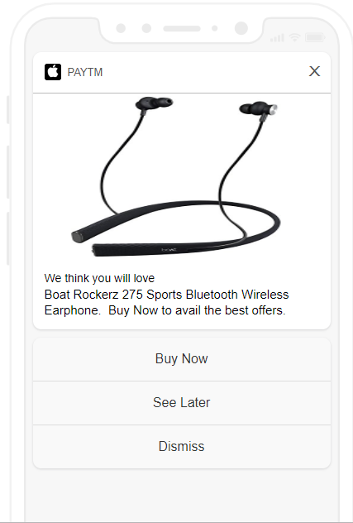
We see how every search affects the whole product database and our probabilistic algorithm takes in these searches and the time spent on the elements and gets us the best product for that user after considering a threshold period of time and search history elements.
The time spent on every product is categorized as follows –
Opted in for the product – 2 units
Checking out the images etc. – 2 units
Checking out product description – 3 units
Checking out product reviews – 3 units

Slide 10
Why us ?

Slide 11
Easy to implement ideas
Ready to plugin code
Industry standard REST APIS
No dependencies on any major external libraries
Great Team

Slide 12
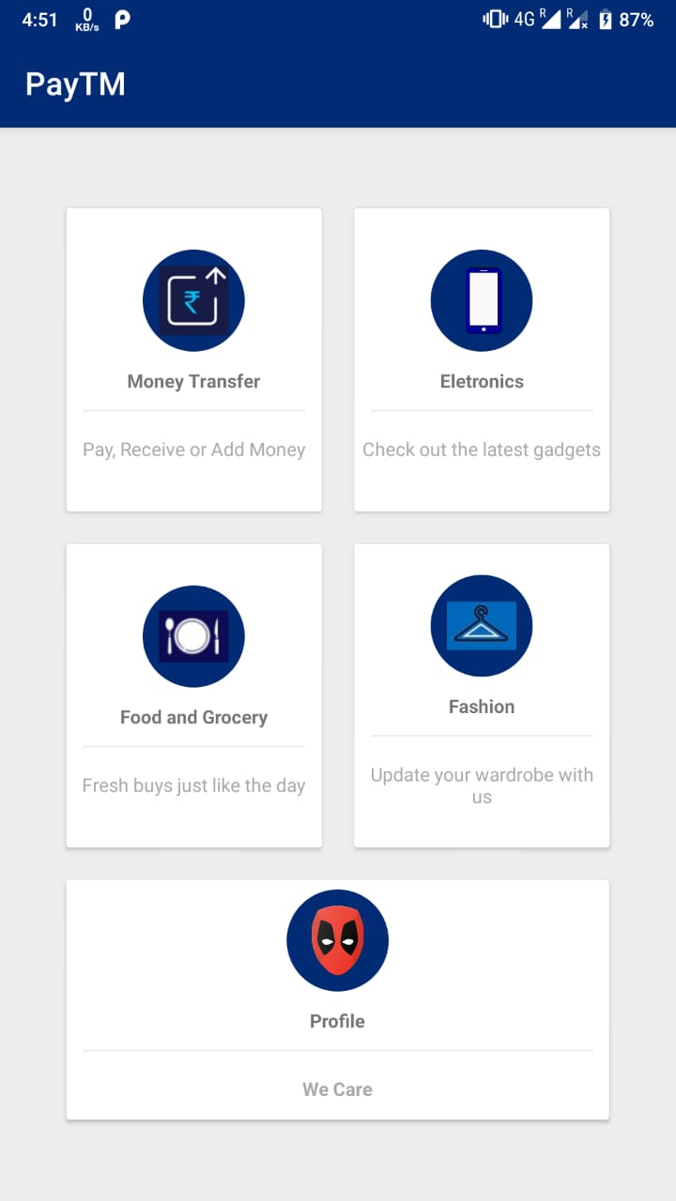
Tech Stack
Flask micro-framework
Rest APIs
Localhost 127:00:00:00
Firebase
Cloud Messaging Client
SQLite3
Android APK

Slide 13
< Code />

Slide 14
Thankyou for listening to us patiently!!
Your questions are welcome….

